Slide 1
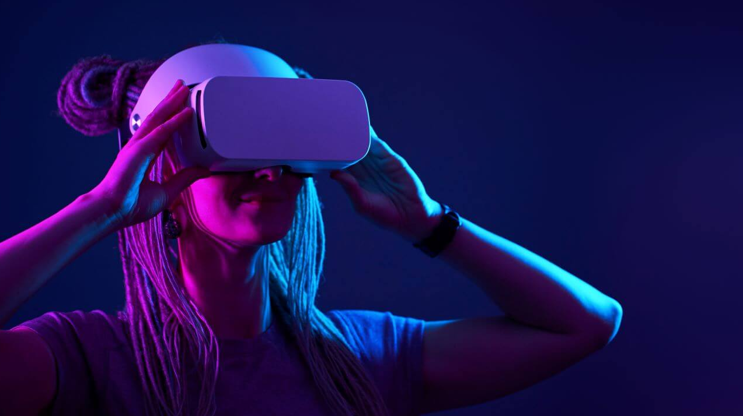
Virtual Reality
“VR is a way to escape the real world into something more fantastic. It has the potential to be the most social technology of all time”

Slide 2
Introduction
What is VR
How does it work?
Why am I interested in it?

Slide 3
Uses for VR
Gaming
Education
Media

Slide 4
VR Development
Indie Game developers
AAA Game developers

Slide 5
Limitations of VR
Hardware limitations
Software
Accessibility

Slide 6

Questions?

